Slide 1
Analyzing H1B Data Using Hadoop Ecosystem
Presented by:
Name: Pravinsing Prakashsing Hajari
Student ID: S171107500148
Center:Pune Deccan

Slide 2
Objective:
This analyzed data used for future plans and policy of h1b visa application.

Slide 3
BIG DATA
Big data is collection of large volume of data.
Big data may be structured or unstructured.
Hadoop is system to analyze the big data.

Slide 4
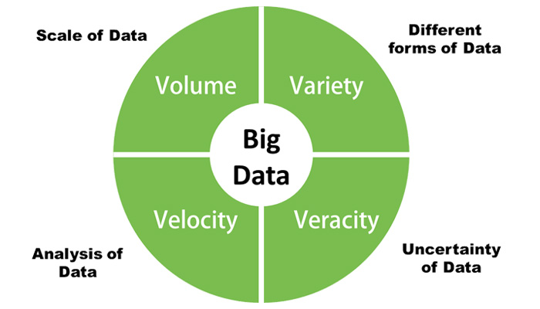
4 V’S OF BIG DATA

Slide 5
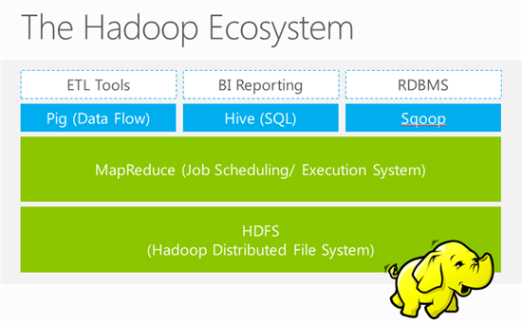
HADOOP ECOSYSTEMS

Slide 6
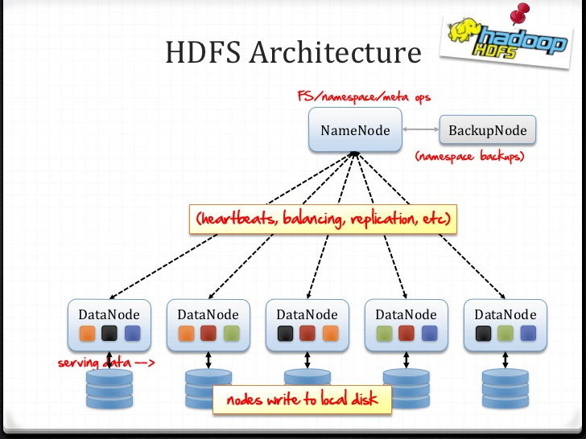
HDFS ARCHITECTURE

Slide 7
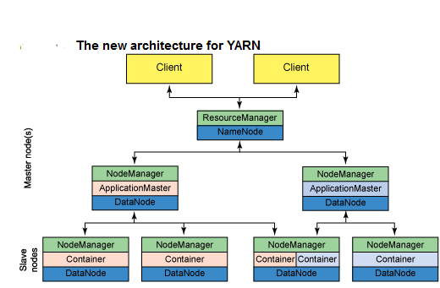
YARN ARCHITECTURE

Slide 8
ADVENTAGES
Scalable: Hadoop is a highly scalable storage platform, because it can store and distribute very large data sets.
Cost effective: Hadoop also offers a cost effective storage solution for businesses' exploding data sets.
Flexible: Hadoop enables businesses to easily access new data sources and tap into different types of data to generate value from that data.
A key advantage of using Hadoop is its fault tolerance.

Slide 9
TECHNOLOGY USED:
Mapreduce: MapReduce is a processing technique and a program model for distributed computing based on java. The MapReduce algorithm contains two important tasks, namely Map and Reduce.
Hive: It is a platform used to develop SQL type scripts to do MapReduce operations.
Pig: It is a procedural language platform used to develop a script for MapReduce operations.
Sqoop: It is used to import and export data to and from between HDFS and RDBMS.

Slide 10
ANALYZING FACTORS
1 a) Is the number of petitions with Data Engineer job title increasing over time?
b) Find top 5 job titles who are having highest avg growth in applications.[ALL]
2 a) Which part of the US has the most Data Engineer jobs for each year?
b) find top 5 locations in the US who have got certified visa for each year.[certified]
3)Which industry(SOC_NAME) has the most number of Data Scientist positions?
4)Which top 5 employers file the most petitions each year? - Case Status – ALL
5) Find the most popular top 10 job positions for H1B visa applications for each year?
a) for all the applications
b) for only certified applications.
6) Find the percentage and the count of each case status on total applications for each year. Create a line graph depicting the pattern of All the cases over the period of time.
7) Create a bar graph to depict the number of applications for each year [All]
8) Find the average Prevailing Wage for each Job for each Year (take part time and full time separate). Arrange the output in descending order - [Certified and Certified Withdrawn.]
9) Which are the employers along with the number of petitions who have the success rate more than 70% in petitions. (total petitions filed 1000 OR more than 1000) ?
10) Which are the job positions along with the number of petitions which have the success rate more than 70% in petitions (total petitions filed 1000 OR more than 1000)?
11) Export result for question no 10 to MySql database.

Slide 11
1 a) Is the number of petitions with Data Engineer job title increasing over time?
TECHNOLOGY USED: PIG

Slide 12
b) Find top 5 job titles who are having highest avg growth in applications.[ALL] TEHNOLOGY USED: PIG
job_title Average Growth
SENIOR SYSTEMS ANALYST JC60, 4255.4
SOFTWARE DEVELOPER 2, 3480.8
PROJECT MANAGER 3, 3233.4
SYSTEMS ANALYST JC65, 2985.0
MODULE LEAD, 2917.2

Slide 13
2 a) Which part of the US has the most Data Engineer jobs for each year? TECHNOLOGY USED: PIG
Worksite Year Count
SAN FRANCISCO, CALIFORNIA 2011 03
SAN FRANCISCO, CALIFORNIA 2012 07
MENLO PARK, CALIFORNIA 2013 10
MENLO PARK, CALIFORNIA 2014 13
SAN FRANCISCO, CALIFORNIA 2015 33
MENLO PARK, CALIFORNIA 2016 35

Slide 14
b) find top 5 locations in the US who have got certified visa for each year.[certified] TECHNOLOGY USED : HIVE
Worksite Year Count
NEW YORK, NEW YORK 2011 23172
HOUSTON, TEXAS 2011 8184
CHICAGO, ILLINOIS 2011 5188
SAN JOSE, CALIFORNIA 2011 4713
SAN FRANCISCO, CALIFORNIA 2011 4711

Slide 15
3)Which industry(SOC_NAME) has the most number of Data Scientist positions? [certified] TECHNOLOGY USED: HIVE
SOC_NAME Count
STATISTICIANS 369

Slide 16
.
4)Which top 5 employers file the most petitions each year? - Case Status – ALL TECHNOLOGY USED:HIVE
Employer Name Year Count
TATA CONSULTANCY SERVICES LIMITED 2011 5416
MICROSOFT CORPORATION 2011 4253
DELOITTE CONSULTING LLP 2011 3621
WIPRO LIMITED 2011 3028
COGNIZANT TECHNOLOGY SOLUTIONS 2011 2721

Slide 17
5)Find the most popular top 10 job positions for H1B visa applications for each year? a) for all the applications TECHNOLOGY USED: HIVE.
Job title Year Count
PROGRAMMER ANALYST 2011 31799
SOFTWARE ENGINEER 2011 12763
COMPUTER PROGRAMMER 2011 8998
SYSTEMS ANALYST 2011 8644
BUSINESS ANALYST 2011 3891
COMPUTER SYSTEMS ANALYST 2011 3698
ASSISTANT PROFESSOR 2011 3467
PHYSICAL THERAPIST 2011 3377
SENIOR SOFTWARE ENGINEER 2011 2935
SENIOR CONSULTANT 2011 2798

Slide 18
b) for only certified applications. TECHNOLOGY USED:HIVE.
Job title YEAR Count
PROGRAMMER ANALYST 2011 28806
SOFTWARE ENGINEER 2011 11224
COMPUTER PROGRAMMER 2011 8038
SYSTEMS ANALYST 2011 7850
BUSINESS ANALYST 2011 3444
COMPUTER SYSTEMS ANALYST 2011 3152
ASSISTANT PROFESSOR 2011 3050
PHYSICAL THERAPIST 2011 2911
SENIOR SOFTWARE ENGINEER 2011 2595
SENIOR CONSULTANT 2011 2585

Slide 19
6) Find the percentage and the count of each case status on total applications for each year. Create a line graph depicting the pattern of All the cases over the period of time.
TEHNOLOGY USED: MAP REDUCE

Slide 20
7)Create a bar graph to depict the number of applications for each year [All] Techbnology used: Mapreduce

Slide 21
8) Find the average Prevailing Wage for each Job for each Year (take part time and full time separate). Arrange the output in descending order - [Certified and Certified Withdrawn.] TECHNOLOGY USED: PIG
JAPANESE TEACHING ASSISTANT 2013 N 17076.0
INSTRUCTOR, PSYCHOLOGY 2013 N 16972.0
ASSISTANT VOLLEYBALL COACH 2013 N 16889.0
DIRECTOR OF RELIGIOUS ACTIVITIES
AND EDUCATION 2013 N 16764.0
COSTUMER 2013 N 16640.0
ASSISTANT WOMEN'S SOCCER
COACH 2013 N 16120.0
BILINGUAL SPECIAL EDUCATION
TEACHER ASSISTANT 2013 N 15080.0

Slide 22
9) Which are the employers along with the number of petitions who have the success rate more than 70% in petitions. (total petitions filed 1000 OR more than 1000) ? Technology used: mapreduce
TECHNOLOGY USED: MAPREDUCE
Employer name Total SuccessRate
HTC GLOBAL SERVICES, INC. 1164 100.0
INFOSYS LIMITED 130592 99.540
DIASPARK, INC. 1419.0 99.506
ACCENTURE LLP 33447.0 99.393
TECH MAHINDRA (AMERICAS),INC10732.0 99.338
TATA CONSULTANCY SERVICES LIMITED 64726 99.337

Slide 23
Which are the job positions along with the number of petitions which have the success rate more than 70% in petitions (total petitions filed 1000 OR more than 1000)? TENOLOGY USED: MAPREDUCE
Job title Total Success Rate
PRODUCTION SUPPORT LEAD – US 1301.0 100.0
ASSOCIATE CONSULTANT - US 4393.0 99.93
SYSTEMS ENGINEER - US 10036.0 99.90
TEST ENGINEER - US 2198.0 99.86
PRODUCTION SUPPORT ANALYST – US 1451.0 99.86
TEST ANALYST - US 4958.0 99.81

Slide 24
11) Export result for question no 10 to MySql database.
1.mysql –u root –p
2. create database h1b;
3. use h1b;
4.CREATE TABLE success rate(job_title varchar(100)NOT NULL,total_no_of_appl INT NOT NULL,certifiedANDcertified_withdrwan_count INT NOT NULL,
5.desc success rate;
+---------------------------------------+--------------+------+-----+---------+-------+
| field | type | null | key | default | extra |
+---------------------------------------+--------------+------+-----+---------+-------+
| job_title | varchar(100) | no | | null | |
| total_no_of_appl | int(11) | no | | null | |
| certifiedandcertified_withdrwan_count | int(11) | no | | null | |
| success rate | float | no | | null | |
+---------------------------------------+--------------+------+-----+---------+-------+
6.Start sqoop…..connect to msql>h1b database
sqoop list-tables --connect jdbc:mysql://localhost/h1b --username root --password 'hduser'

Slide 25
Conclusion:
By using Mapreduce We can easily analyaze the complex data.
Hive is very efficient for analyze structure data.
For normal group by join and filter based data retrieval ,Pig is very efficient
Sqoop is very important to import and export the data.

